Slide 1

TWITTER SENTIMENT ANALYSIS
Prashanth Javaji(RA2011026010002)
Vivek Reddy D(RA2011026010059)
Suhas A(RA2011026010050)

Slide 2


PROBLEM STATEMENT
we need to develop an Automated Machine Learning Sentiment Analysis Model to compute the customer perception. In this project, we try to implement a NLP Twitter sentiment analysis model that helps to overcome the challenges of identifying the sentiments of the tweets.

Slide 3
Introduction:
Sentiment analysis refers to identifying as well as classifying the sentiments that are expressed in the text source. Tweets are often useful in generating a vast amount of sentiment data upon analysis. These data are useful in understanding the opinion of the people about a variety of topics.
we aim to analyze twitter sentiment analysis using machine learning, the sentiment of the tweets provided from the Sentiment140 dataset by developing a machine learning pipeline involving the use of three classifiers (Logistic Regression, Bernoulli Naive Bayes, and SVM)along with using Term Frequency- Inverse Document Frequency (TF-IDF). The performance of these classifiers is then evaluated using accuracy and F1 Scores.

Slide 4
MACHINE LEARNING ALGORITHMS (CLASSIFIERS) WE MADE USE OF… (proposed methodology)
In the problem statement we have used three different models respectively :
Bernoulli Naive Bayes
SVM (Support Vector Machine)
Logistic Regression
The idea behind choosing these models is that we want to try all the classifiers on the dataset ranging from simple ones to complex models and then try to find out the one which gives the best performance among them.

Slide 5
WHY BERNOULLI NAIVE BAYES ?
As, said in the previous slide we are going to make use of all the three classifiers on the dataset out of which we are going to consider the one which shows the best performance. Considering Bernoulli Naive Bayes algorithm, Bernoulli Naive Bayes is one of the variants of the Naive Bayes algorithm in machine learning. It is very useful to be used when the dataset is in a binary distribution where the output label is either present or absent.
Considering this case of twitter sentiment analysis with the aspect to when the sorting out process of whether the particular tweets implies to be with a positive note or negative note, we can do this process easily with the help of Bernoulli Naive Bayes. As, we know this algorithm will only work with the feature of only Yes or no

Slide 6
WHY SVM ?
Support Vector Machine or SVM is one of the most popular Supervised Learning algorithms, which is used for Classification as well as Regression problems. However, primarily, it is used for Classification problems in Machine Learning. So, this implies that we can make use of SVMs for this analysis because of its best feature of creating the best line or decision boundary that can segregate n-dimensional space into classes so that we can easily put the new data point in the correct category in the future. This best decision boundary is called a hyperplane. This helps us out in segregation of the words in a tweets which would sum up the main sentiment or to be precise the opinion of the person who tweets can understood easily.

Slide 7
WHY LOGISTIC REGRESSION ?
We can understand the fact that Twitter sentiment analysis is a classification problem, we thought of using few of the best algorithms which are good at classification problems. But one of the other best algorithm which could solve this issue is Logistic regression. Logistic Regression is a significant machine learning algorithm because it has the ability to provide probabilities and classify new data using continuous and discrete datasets.Logistic Regression can be used to classify the observations using different types of tweets and can easily determine the most effective words or the variables used for the classification.

Slide 8
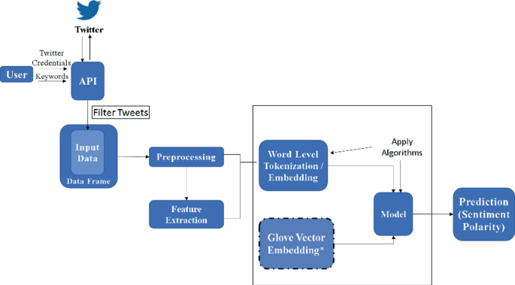
Architectural diagram:

Slide 9
WHICH
ONE OF THIS ALGORITHMS
TURNED OUT TO BE THE BEST ONE AMONG FOR THE ANALYSIS ?

Slide 10
ITS LOGISTIC REGRESSION

Slide 11
We made use of three use the following evaluation parameters to check the performance of the models respectively :
Accuracy Score
Confusion Matrix with Plot
ROC-AUC Curve
Accuracy: As far as the accuracy of the model is concerned Logistic Regression performs better than SVM which in turn performs better than Bernoulli Naive Bayes.
F1-score: The F1 Scores for class 0 and class 1 are :
(a) For class 0: Bernoulli Naive Bayes(accuracy = 0.90) < SVM (accuracy =0.91) < Logistic Regression (accuracy = 0.92)

Slide 12
(b) For class 1: Bernoulli Naive Bayes (accuracy = 0.66) < SVM (accuracy = 0.68) < Logistic Regression (accuracy = 0.69)
AUC Score: All three models have the same ROC-AUC score.
We, therefore, conclude that the Logistic Regression is the best model for the above-given dataset.

Slide 13
Data Sets:
The Twitter sentimental analysis mini project is based on a CSV file that contains data related to tweets. The dataset is a collection of tweets on a specific topic, and it includes information such as the tweet ID, timestamp, user, sentiment score, and the tweet text itself. The CSV file format is ideal for storing tabular data, and it is commonly used for this purpose.
The objective of the project is to analyze the sentiments expressed in the tweets. This analysis involves using natural language processing techniques to identify and classify the polarity of the tweets as either positive, negative, or neutral. The project aims to provide insights into the sentiments of people towards a particular topic based on their tweets.

Slide 14
THANK YOU

